Slide 1

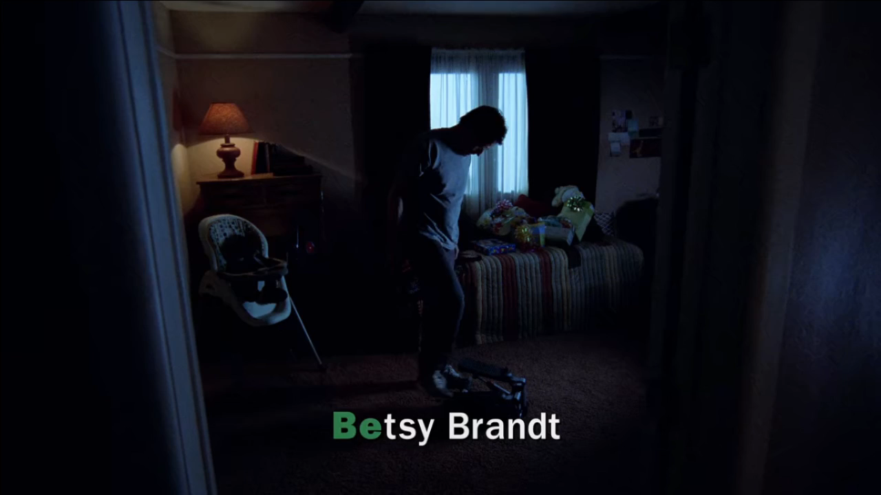
https://subslikescript.com/series/Breaking_Bad-903747/season-1/episode-1-Pilot

